Slide 1
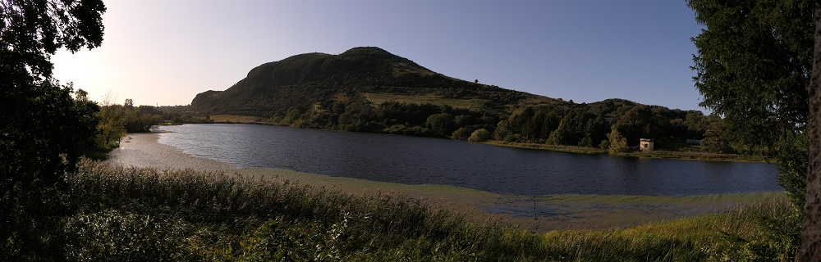

Scottish Wildlife Trust Lothians Group
Annual General Meeting – 16th April 2026

Slide 2
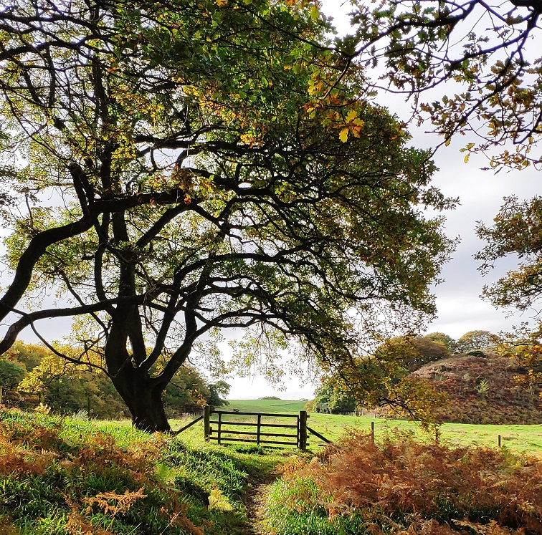
Scottish Wildlife Trust Lothians Group – AGM 2026
Agenda
Approval of the annual report
Approval of the group’s verified account
Elections of office bearers

Slide 3
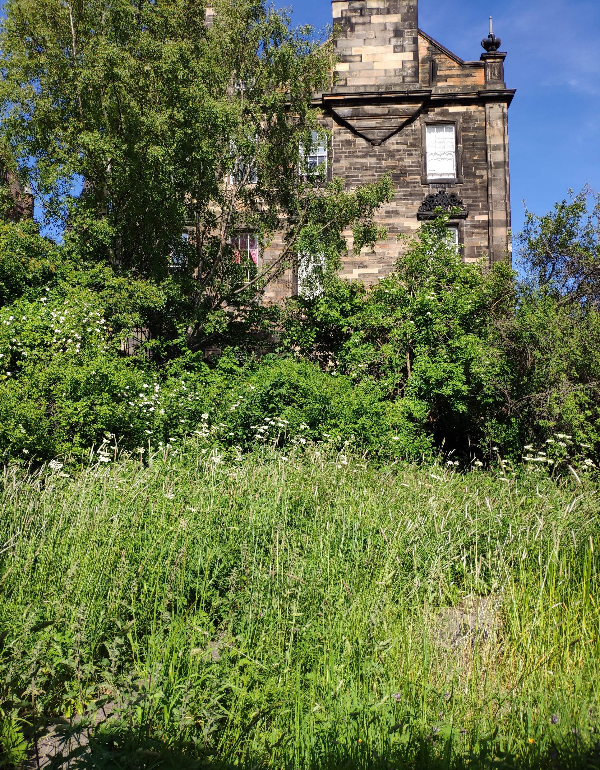
Annual Report Highlights
Walks & Talks: 11 events, 5 of these were outings, the other six were organised talks which took place at the Cornerstone Centre off Princes street, Edinburgh or online.
Our newsletter goes out 3 times a year to over 12,000 members (over 6,000 memberships) in the Lothians.
We maintain a webpage - https://swtlothians.org.uk/
The reserve committee supports the management of the Trust Lothians reserves and met once this year on the 24th of February 2026 to discuss past and future activities.
Planning Matters - Monitoring the threats to Local Biodiversity Sites and LBS site assessments.
Fundraising.

Slide 4
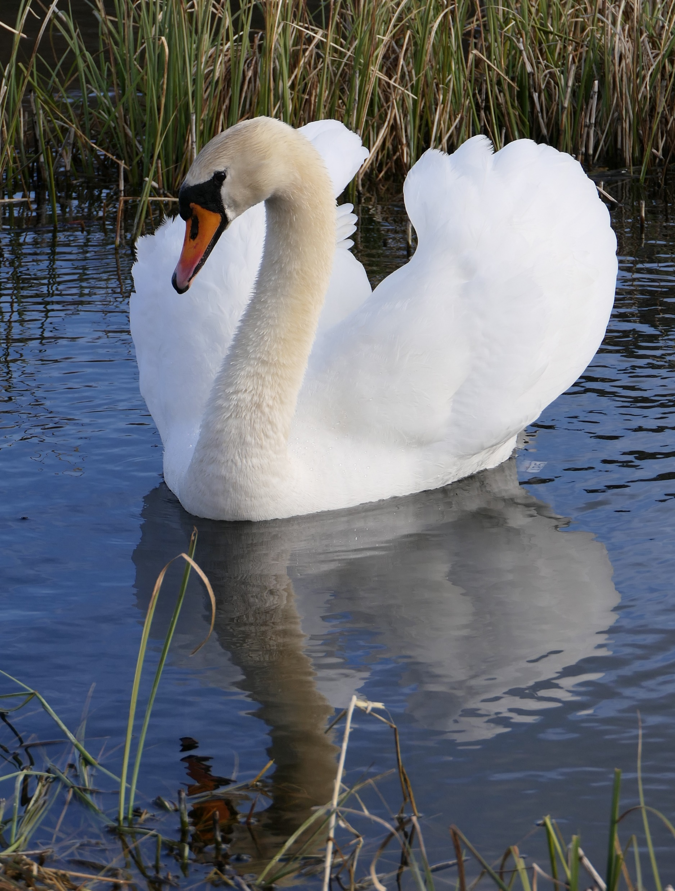
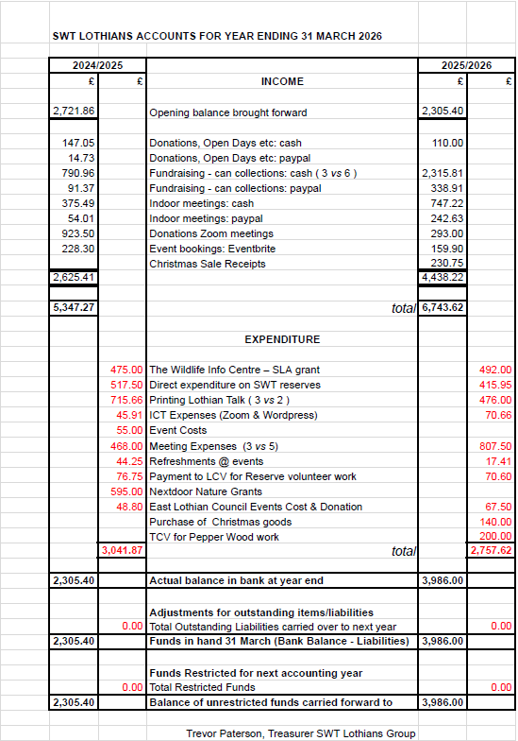
Financial Accounts - Income

Slide 5
Financial Accounts - Expenditure

Slide 6
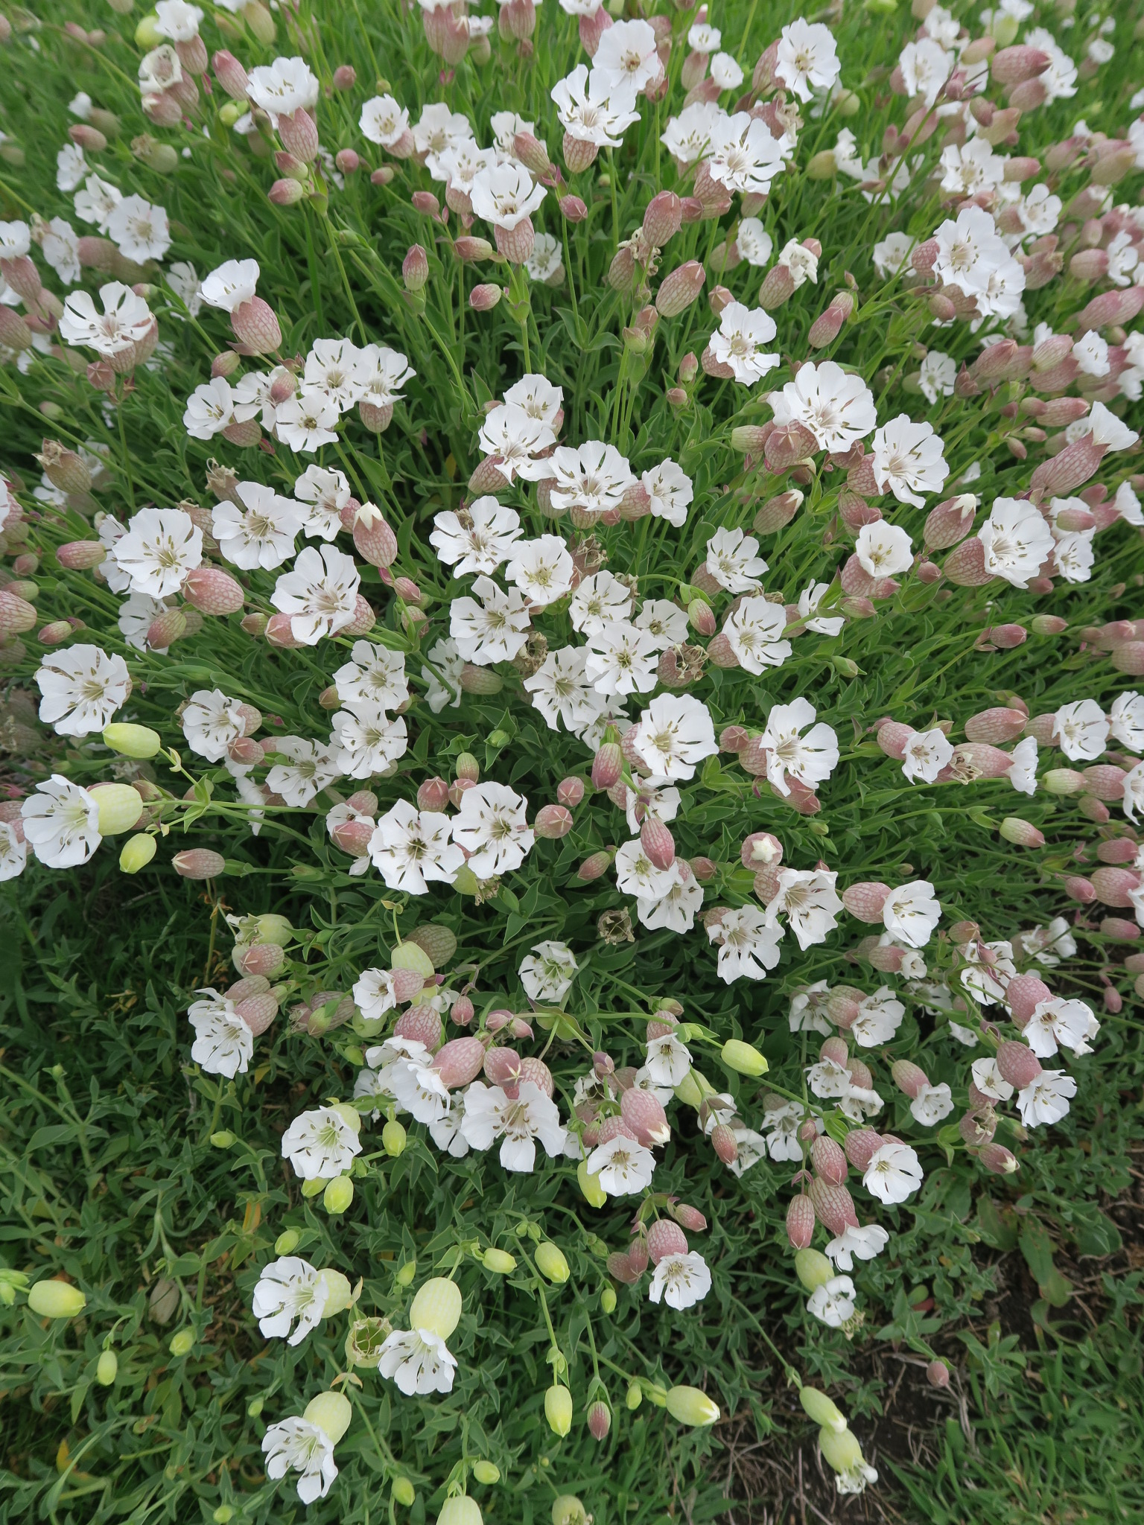
Lothians Group proposed Committee
Chair: Kate Walters
Vice Chair: Colin Murray
Secretary: Vacant
Treasurer: Trevor Paterson
Planning Secretary: Tim Duffy
Fundraising Coordinator: Barbara Knowles with support from the Treasurer.
Events Coordinator: Colin Shepherd
Publicity, Editor ‘Lothian Talk’: Ash Caton
Webmaster: Colin Murray
Social Media: Vacant – on hold
Ordinary Members: Nicholas Warren
Ex Officio Members:
SWT Lothians Reserves Manager - Julian Warman
Reserves Convenor Group Chair: Nicholas Warren
Planning representatives:
East Lothian - Tim Duffy
Midlothian - Alison Macfadyen
City of Edinburgh Council - Nicki Lundy
West Lothian - Vacant

Slide 7
